Slide 1

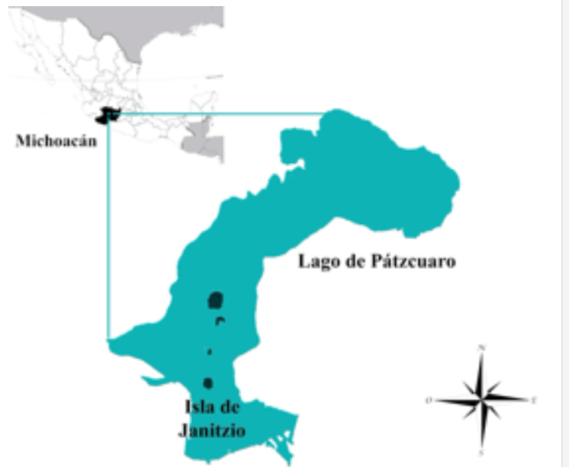
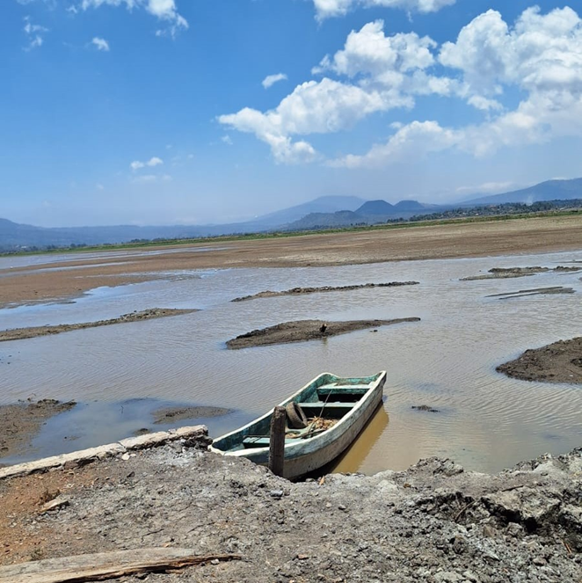
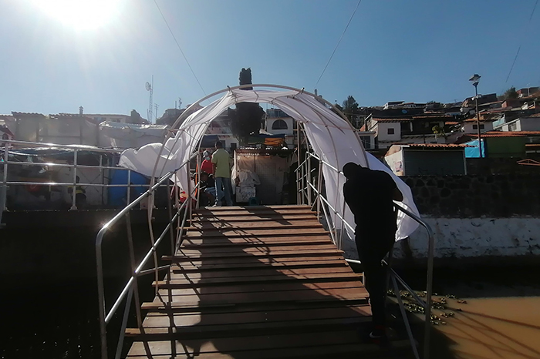
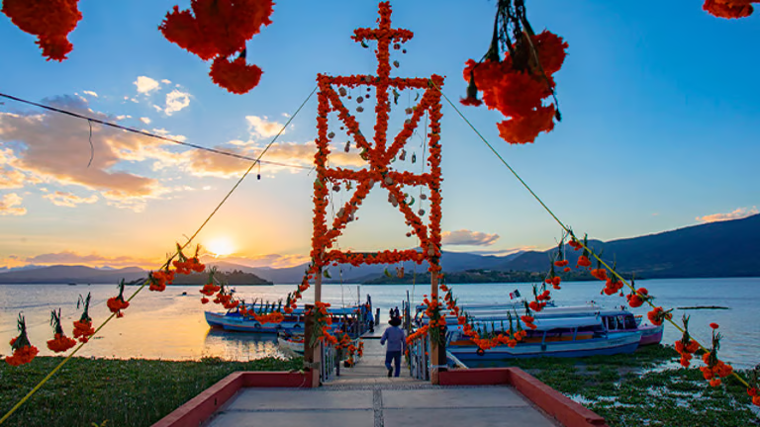
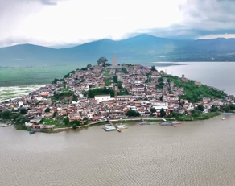
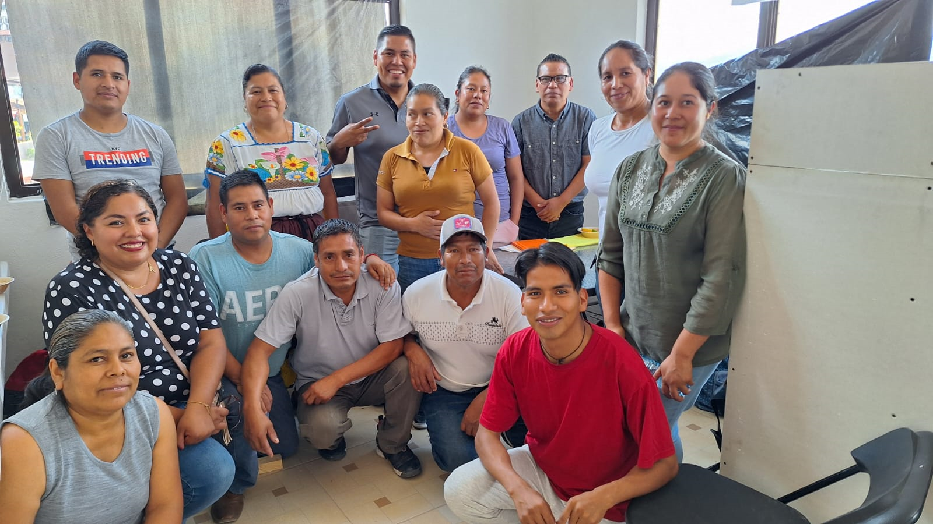





Analysis of the impact of COVID -19 on the economic and social sectors of the indigeno/mestizo community of Janitzio Michoacán 2020 – 2023 and community response.
Authors: Aidé García Villa, Ollin Demian Langle Chimal
Introduction
Methodology
When carrying out an analysis of the impact of COVID-19, it is necessary to focus on society as the fundamental factor to give it that value as an indigenous community that has a collection of customs and culture that is very enriching for the place.
Janitzio Island is one of the holdings belonging to the municipality of Pátzcuaro within the State of Michoacán. It is located 2035 meters above sea level and referenced within the coordinates 19º 34' 26" north latitude and 101º 39' 3" west latitude. Its population is 2458 inhabitants.
A mixed research method was used that includes the application of socioeconomic surveys to various sectors of the island's population (merchants, housewives, fishermen, day laborers, etc.) who were the most affected actors. Qualitative interviews and a participatory workshop are considered for the community construction of new responses to pandemics and the environmental problems that exist, and which are expected to result in the improvement of the rural community. It allowed us a contextual description of the situation of society during the pandemic, its effects due to confinement, and all the problems it implied.
With the participatory workshop, various strategies were analyzed and carried out from the point of view of the population, prevention activities and new alternatives for better development in the population of Janitzio in its economic, social and environmental aspects
Contextualization of the Problem
There are several elements to take into account why COVID expressed itself in a certain way in Janitzio and how it was faced. A problem this complex requires being evaluated in order to build community alternatives (which includes the government and residents) that face imminent health and environmental catastrophes. Let's look at some of these elements:
The health sector on the island. In the town of Janitzio Michoacán there is a problem in that it has a very small Health Clinic for a population of 2,500 inhabitants and that there is no other type of alternative that provides such a service, due to this they must move to the city ​​of Pátzcuaro to be treated in private clinics or in some other option in the health sector
The environmental issue. The overexploitation of the lake, the contamination of the place Several studies assert that Lake Pátzcuaro has been exposed to environmental deterioration and increasing eutrophication in recent decades The main causes of this alteration were: the deforestation of large areas of coniferous forests and of mixed forests due to the introduction of the railway in the region, opening of agricultural spaces, livestock activity in spaces with eco-geographic fragility, excessive fishing activity, indiscriminate use of agrochemicals, flow of sewage and unplanned growth of urban spaces among others.(Almanza, 2016).
The weak institutional structure and functionality: The low response to the execution of projects that support that the island can become a greater boost for the region, considering as its main essence the population that is an important piece and that its behavior will depend fully to achieve changes for great benefits that the place requires, after a COVID-19 pandemic that considers housewives who contributed to facing such a disease as a fundamental role.
Tourism as the main source of income is part of the essence due to its cultural richness in its different spaces, so it is important to note that by stopping the entry of large numbers of visitors there is a high economic impact on the Lake Pátzcuaro basin. Because there are different sectors of the population that benefit from this activity, such as artisans, fishermen, providers of various services, boatmen, among others, this being their main source of employment.
Socioeconomic problems Janitzio has different problems that have arisen over time, among the most alarming are alcoholism, extinction of local species endemic to the area, fishing disorder, pollution of boats, and the constant increase in wastewater. , ambulance (Cruz, 2017).
Results
IMPACT OF COVID-19 ON THE POPULATION OF JANITZIO MICHOACÁN 2020 to 2023
A comparative analysis of the data from the Mexican Republic, Michoacán, Pátzcuaro and Janitzio to establish the dimension of the data.
The 30 deaths in Janitzio reflect that 1% of its population died, this was reported by the different authorities of the Island as well as its cemetery and part of these figures were provided by the health system.
It is estimated from the data determined by the community doctor that the greatest impact was, in the case of men, because they were the ones who had problems with smoking, alcoholism and obesity, which gave rise to disease will develop more frequently and this can be verified by referring to the thesis of M.C. José De La Cruz (Cruz, 2017) who tells us the following: “In relation to the issue of health on the island of Janitzio, it was identified that there are important changes in the diet of its food culture, reflected in the increase in diseases such as obesity and diabetes Mellitus among its population.
Threats
Becoming a Peninsula The Island Community Committee considers that there would be many additional repercussions of becoming a peninsula, social problems could increase (alcoholism, theft, crime, etc.) that would have consequences on the population.
Water pollution The waters that receive the desilting of drainage water into the interior of the lake through a water treatment plant that is located in the western part of the island, although it is not 100% functional, which would help the water enter the lake is in optimal conditions, but due to lack of maintenance and new technological alternatives for such improvement.
Lack of quality spaces, there are few spaces designated for this, the residents believe that there should be options so that they can recreate in the afternoons, especially outdoors, in closed spaces some recreational activities are usually carried out.
Deterioration of its tourist services Transportation sometimes has the problem that the boats, due to their age, are many years old and constantly suffer from deterioration and lack of maintenance, causing them to get stuck or leave or start due to some mechanical failure.
The accommodation is somewhat insufficient and only the cabin area is the one that is in optimal conditions, the hotels do not have sufficient infrastructure.
Opportunities for Janitzio Island
Tourist services They have a global image that is sustained, Economic possibilities of a more diverse tourism delving into the economic, social and cultural well-being of the community.
Transform means of transportation with other activities to seek greater entertainment for tourists.
Place | Population | Affected | Deaths
MÉXICO | 126,014,024 | 7,633,335 | 334,336
MICHOACÁN | 4,748,846 | 118,391 | 8,803
PÁTZCUARO | 98,382 | 3,250 | 223
JANITZIO | 2,352 | 235 | 30
Technological Reflections
For Janitzio, it is important to highlight that it would be necessary to incorporate strategies for the community where technology could collaborate in terms of health and areas of opportunity that are required to be able to solve different health problems, such as the fact that telemedicine could exist or be provided through development. of artificial intelligence assistance.
Technology would be important to provide a prompt and timely solution to water problems and wastewater treatment, which have not had the expected success, as intended, with the aim of making better use of resources through new models of sustainable measures that collaborate with the development of the Island and its population.
Relevant Literature
Cruz, J.L. (2017). Transformations of an indigenous community of fishermen associated with tourist activity: the case of the island of Janitzio, Michoacán.
Segura, G. (1997). Reproductive ecology of the whitefish Chirostoma Jordan blind. In G. V. Segura. Mexico: Master's Thesis in Ecology.
INEGI (2020) Population census and COVID-19 DataCONACYT.mx

